Slide 1
Bridging the gap between science and decision-making through the rapid prototyping of decision support tools
Denis Valle
drvalle@ufl.edu
http://denisvalle.weebly.com/
School of Forest Resources and Conservation
University of Florida
November, 2020

Slide 2
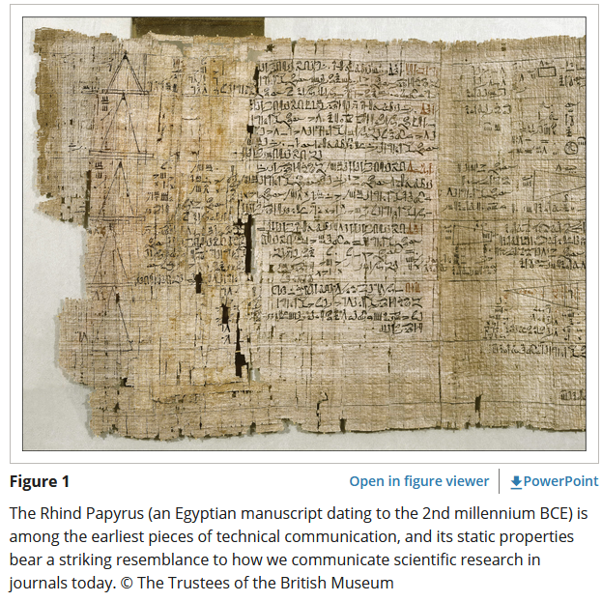
Interactive visualizations/dynamic figures (Stanton Jr. et al 2017):
- “static figures that display model predictions are typically conditioned on a single set of ecological conditions. For example, wildlife researchers using regression models often plot how a single factor affects a predicted outcome, while keeping all other variables fixed at their respective mean values”

Slide 3
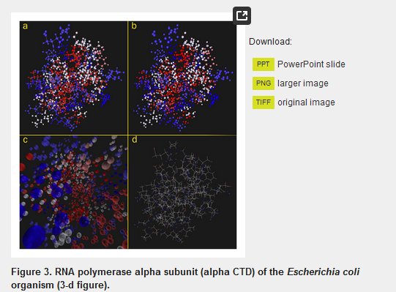
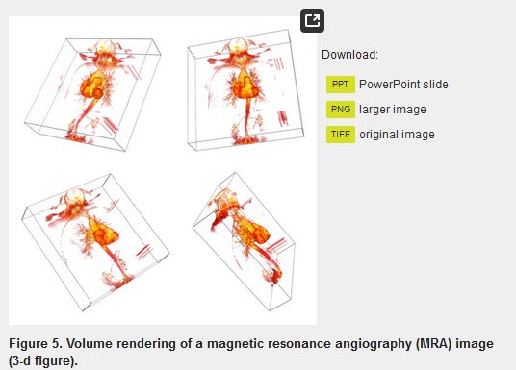
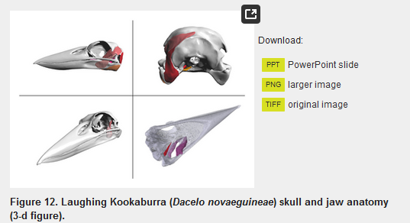
Interactive visualizations/dynamic figures (Barnes et al 2013 PLOS One):
Protein molecule
Structural magnetic resonance imaging
Segmented anatomical structure

Slide 4
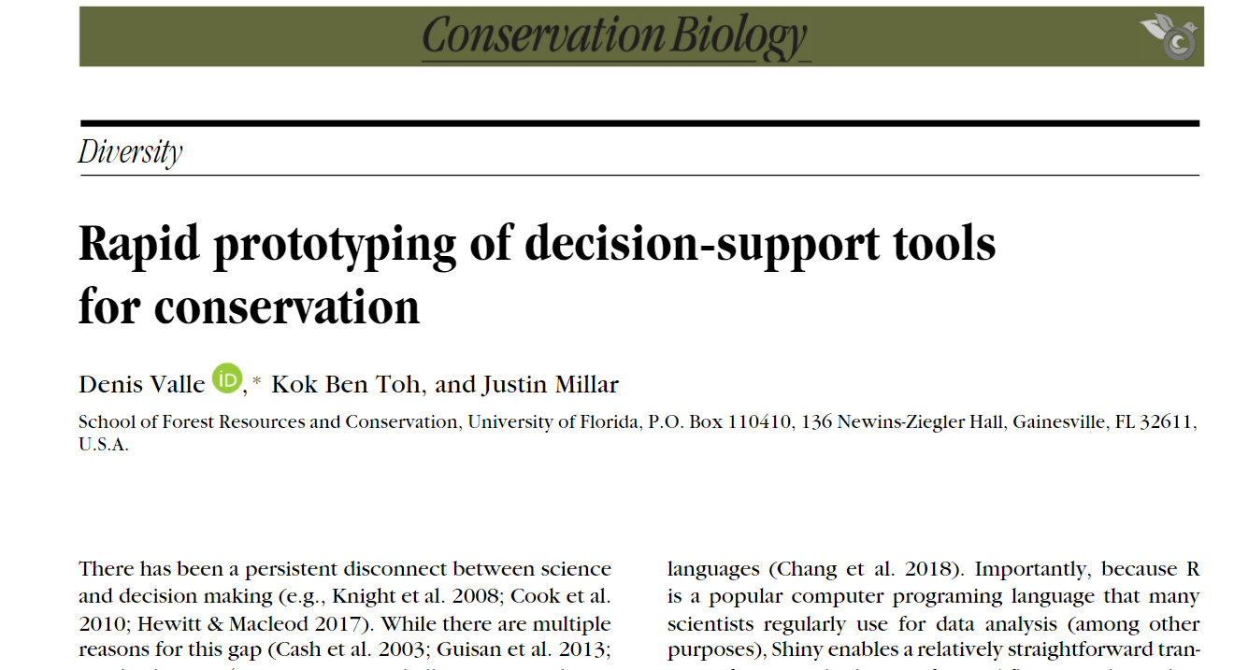
The problem:
Persistent disconnect between science and decision making
Scientific articles are not an effective way to communicate with policymakers and practitioners
Potential solution:
Moving beyond interactive visualizations
Using Shiny to transition from scientific workflows (data analysis, modeling, and visualization) to prototyping of decision support tools
(Valle et al 2019)

Slide 5
Shiny
- Web-based decision support tools:
cross-platform,
free at the point of use,
available to and easily accessed by a wide range of users without the need to install additional software
Shiny package in R enables the development of interactive web-applications without prior knowledge on JavaScript, HTML, and CSS
Because so many scientists use R for data analysis (among other purposes), Shiny enables a straight-forward transition from scientific workflows (data analysis, modeling, and visualization) to prototyping of decision support tools

Slide 6
Statistical models
Decision support tools
Economic and value-based parameters

Slide 7
Examples in the literature:
Wildlife population dynamics (Wildlife health lab at Cornell University): https://cwhl.vet.cornell.edu/resources/tools-data
Tradeoffs between human-environmental health and economic growth from palm oil production (EcoHealth Alliance): http://ideeal.eha.io/
Land cover and agricultural practices effects on gamebird (USGS/University of Nebraska-Lincoln): https://pheasant.shinyapps.io/pheasanthabitatsimulator/ (Wszola et al. 2017)
Fisheries management (University of Florida/ Theodore Roosevelt Conservation Partnership): https://zsiders.shinyapps.io/uf_rs_mse_decisiontool/
Optimal allocation of funds for endangered species allocation (U.S. Fish and Wildlife Service/Arizona State University): https://shiny.sesync.org/apps/RecoveryExplorer/ (Gerber et al. 2018)
More examples: https://shiny.rstudio.com/gallery/

Slide 8
The time is ripe for scientists to engage in the development of prototypes of decision support tools as an effective way to deliver scientific information to practitioners, managers and policy-makers, ensuring that this information is usable in the decision-making process

